Slide 1
SAFE & INCLUSIVE TOOLKIT
FOR OUTLET
Developed by Desperados, wel jong AND Pixiels

Slide 2
CONTENT
INTRODUCTION ON THE REASON WHY
GOOD UNDERSTANDING OF SAFETY AND INCLUSIVITY IN NIGHTLIFE
HOW TO OPTIMIZE YOUR OUTLET?
SITUATION EXAMPLES

Slide 3
WHAT IS GOING ON IN THE NIGHTLIFE?

Slide 4
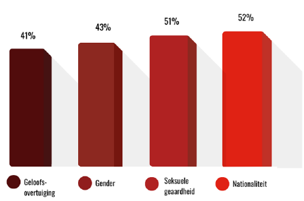
BEING ABLE TO PARTY FREELY, WITHOUT PREJUDICE, IN SAFETY AND WITH RESPECT FOR EACH OTHER. IT SOUNDS LIKE MUSIC TO OUR EARS, BUT UNFORTUNATLY IT IS NOT THE REALITY
1 in 5 Belgians pay attention to what attire they wear while partying for fear of borderline behavior.
3 in 5 Belgians are saying that nightlife has become more unsafe in recent years'
7 in 10 encounter discrimination while going out based on
4 in 5 Belgians feel unsafe while going out
Source: iVOX study 2023 (2.000 Belgians 18-40 y.o.

Slide 5
WHY DOES DESPERADOS TAKE THIS INITIATIVE
PARTYING IS A WAY TO CREATE MEMORABLE CONNECTIONS & EXPERIENCES. HOWEVER, LACK OF SAFETY & INCLUSIVITY CAN GET IN THE WAY OF PEOPLE LETTING LOOSE.
DESPERADOS WANTS TO CONTRIBUTE TO MAKE SURE PEOPLE FEEL MORE INCLUDED AND SAFER WHEN GOING OUT WITH THEIR TRIBE. BECAUSE DESPERADOS BELIEVES THAT WHEN YOU FEEL GOOD, YOU CAN FULLY LET LOOSE.
RESPECT IS THE BEAT WE DANCE TO!

Slide 6
IT ALL STARTS WITH A GOOD UNDERSTANDING

Slide 7
Safety and inclusiveness in nightlife mean creating an environment where everyone feels welcome and safe, regardless of background, identity or ability (limitations, financial). This requires accessible venues, proactive and trained staff, clear rules against inappropriate behavior, and continuous improvement based on feedback.
INCLUSIVE NIGHTLIFE
A safe(r) space is a place where you can be yourself, where you can unwind, and where you can go with questions or for conversation. A safe environment looks different for everyone because everyone has different needs and requirements. Important to note that a safe(r) space can be either a physical location or place, but it can also be a context, such as a friendship where you feel safe to be yourself or an organization.
SAFER SPACES
Consent means asking someone for permission before doing something. Consent also means that someone must give you permission to do something. Consent is verbal, clear and mutual. (e.g., ask if you can touch someone, wait for their response before acting). Consent is retractable.
CONSENT
This is an acronym to denote sexual, gender and sex diversity. L= lesbian, G= gay (homosexual), B= bi+, T= trans(gender), Q=queer or questioning (searching), I= intersex and A=asexual.
LGBTQIA+

Slide 8
HOW TO MAKE YOUR OUTLET MORE INCLUSIVE AND SAFE

Slide 9
BEFORE
OPENING
DURING
THE EVENING/NIGHT
AFTER
THE EVENING/NIGHT
Install clear house rules (example template on next slide):
Make sure the house rules are visible in the outlet via posters or TV-screen
Do not forget the aftercare (e.g. follow-up on lost items, questions, complaints,..)
Make sure to actively follow-up on the house rules
Inform the consumer about the accessibility (Information about public transport, stairs, elevators,..).
Make sure the accessible information is permanently searchable on your webpage, social media account or on the event page
Make the care-team/person or number visible and reachable so they can help your consumer if needed (e.g. not feeling good, to help you to get home safe)
Promote don’t drink & drive
Club/event specific:
The care-team can walk through the venue to make sure people know who they are if they need help (e.g. develop recognizable T-shirts to increase the awareness).
Or create a safety booth to help people in need
Club/event specific:
Contact number should be available 2 weeks after the event to make sure that people have the chance to search for help later on
Train & support the bar staff on safety & inclusivity
Provide gender-inclusive toilets
Highly recommended to have a quiet space

Slide 10
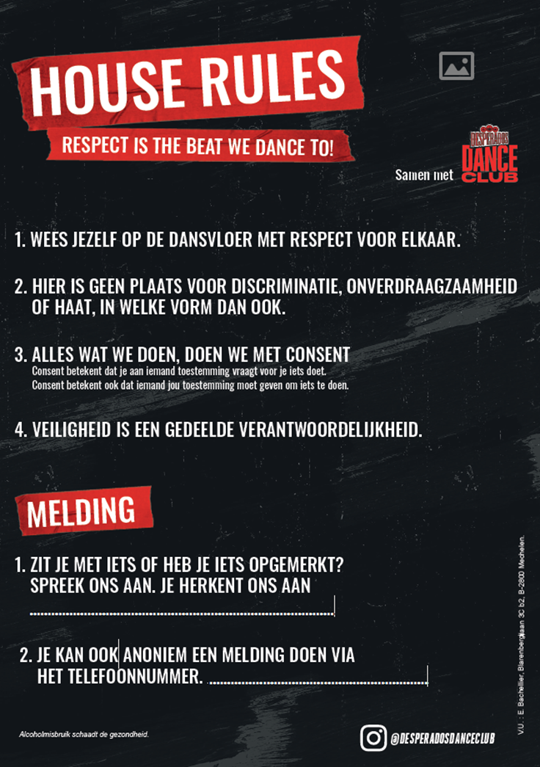
HOUSE RULES EXAMPLE THAT YOU CAN ADJUST FOR YOUR OUTLET

Slide 11
HOW TO HANDLE CERTAIN SITUATIONS

Slide 12
You overhear colleagues talking about different people on the dance floor. The language used can be offensive to the individuals involved. What do you do? Multiple answers possible.
A. You address the group of colleagues and explain that this can be offensive.
B. You address the group of colleagues, telling them that they are talking loudly and that they should discuss it more quietly.
C. You feel uncomfortable directly confronting the group, so you explain the situation to your supervisor.
Notes:
Correct answer A & C:
If you feel comfortable addressing the group, it is very good to do so. If you do not feel comfortable and you discuss it with your supervisor, that is also a correct action. It is important to inform the group that such behavior can be offensive to the individuals involved.

Slide 13
You see someone stumbling towards the bar. It's clear that they're very drunk. The person orders an alcoholic drink. Which response is most appropriate?
A. You give the person their ordered drink. It's their responsibility.
B. You explain to the person that you cannot serve alcohol anymore and offer various non-alcoholic drinks.
C. You explain that you cannot serve the person any more alcohol and inform the designated contact point to take them aside for further assistance.
Notes:
Correct answer C:
You need to explain to the person why you can't serve them alcohol anymore. Additionally, it's good to inform the designated contact point, who can handle the situation professionally.

Slide 14
You see a group of friends on the dance floor nudging each other, repeatedly looking at the same person, and mimicking their dance moves, followed by laughter. What do you do? Multiple answers possible.
A. You approach the group of friends and let them know that such behavior can be hurtful.
B. You don't take any action because it's not your place to intervene.
C. You don't feel comfortable directly addressing the group, so you inform the designated contact point.
Notes:
Correct answer A & C:
If you feel comfortable approaching the group, it is a good response. If you don't feel comfortable and you report it to the designated contact point, that is also a correct action. It is important to inform the group that such behavior can be hurtful to the individuals involved.

Slide 15
You have noticed someone sitting on the side of the dance floor with their eyes closed for a while. They seem to be peacefully sleeping. What do you do?
A. You continue walking because it's not your responsibility to inquire if everything is okay.
B. You approach the person and try to engage with them. If there is no response, you walk away because you tried.
C. You approach the person and ask if everything is okay and if you can help in any way. If necessary, you accompany them to the designated contact point.
Notes:
Correct answer C:
The only correct thing to do is approach the person and inquire about their well-being. If necessary, you can accompany the person to the designated contact point, where they will provide appropriate support.

Slide 16
Under which circumstances should you contact the local designated contact point? Select all correct answers.
A. To report a dispute with a coworker.
D. When you see someone reacting poorly.
B. When someone reports witnessing verbal or physical violence.
E. If you have become a victim of verbal or physical violence.
C. When you observe unwanted harassment at the event.
Notes:
Correct answer B, C, D & E:
You should contact the local designated contact point when someone reports witnessing verbal or physical violence, or when you yourself are a victim. Additionally, you should contact the designated contact point if you witness unwanted harassment or if you see someone reacting poorly. In the above cases, it is good to inform the contact point so that they can handle the situation professionally.

Slide 17
The venue is crowded, and everyone seems to be having a good time. However, you notice an incident happening in the distance. It's not clear what exactly happened, but the commotion keeps growing. How can you react? Multiple answers possible
A. You approach the individuals involved in the incident and speak to only the affected party separately.
C. You approach the individuals involved in the incident and speak to both parties separately to better assess the situation.
B. You're not sure what to do, so you ask for help from your supervisor.
D. Do nothing. It's not my responsibility
Notes:
Correct answer B & C
If you're unsure what to do, it's okay to approach your supervisor to find a solution together. It's also a good response to talk to both parties involved and gather information before drawing conclusions, as you were at a distance. Once the situation is clarified, evaluate the perpetrator's behavior for appropriate follow-up.

Slide 18
RESPECT IS THE BEAT WE DANCE TO!
THANK YOU!

